Slide 1


Blackson
16.08.2025

Slide 2

Outline
Executive Summary
Introduction
Methodology
Results
Conclusion
Appendix

Slide 3
Methodology
Executive Summary
Data collection methodology:
Describe how data was collected
Perform data wrangling
Describe how data was processed
Perform exploratory data analysis (EDA) using visualization and SQL
Perform interactive visual analytics using Folium and Plotly Dash
Perform predictive analysis using classification models
How to build, tune, evaluate classification models

Slide 4
Introduction
Background & Context SpaceX aims to reduce launch costs by reusing Falcon 9 first-stage boosters. Understanding the drivers of landing success is crucial for planning, reliability, and cost efficiency.
Objective Analyze historical launch data to identify factors that influence landing outcomes and build a classifier that predicts success vs. failure.
Data Sources SpaceX REST API (launches, cores) and curated web data (e.g., Wikipedia) combined into a clean analytics table.
Scope Exploratory analysis, interactive visuals (maps & dashboard), and supervised learning with multiple baseline models.
Contributions Clear feature insights (payload, orbit, site, booster version, flight number) and an evaluated model for success prediction.

Slide 5

Section 1

Slide 6
Data Collection – SpaceX API
Access: Query SpaceX REST endpoints for launches/cores; specify filters (date range, site, outcome).
Pagination & Rate-limits: Loop through pages; respect retry/backoff.
Normalization: Flatten nested JSON (launch, core, payload) into tabular fields: flight_number, date, site, payload_mass_kg, orbit, booster_version, landing_outcome.
Join Keys: Merge multi-endpoint data on flight_id / core_serial / rocket.id.
Validation: Check nulls/types, enforce units (kg), deduplicate by flight_number + date.
Output: Save cleaned table (CSV/Parquet) for EDA/SQL/modeling.

Slide 7
Data Collection - Scraping
Targets: Structured tables on reputable sources (e.g., mission pages/Wikipedia) to enrich orbit, payload, outcomes.
Fetching: Request HTML with a standard user agent; follow robots.txt; add polite delays.
Parsing: Use pandas.read_html / BeautifulSoup to extract tables; select/rename relevant columns.
Cleaning: Normalize date formats/timezones; convert payload to numeric kg; standardize orbit labels.
Labeling: Map textual landing outcomes to a binary/class label (e.g., Success (drone ship) → Success).
Reconciliation: Left-join scraped tables to API data by flight_number + date (+ site); resolve conflicts with simple rules (API preferred).

Slide 8
Data Wrangling
Standardize & Normalize
Convert column names to snake_case; enforce types (dates → datetime, payload → kg).
Unify categorical labels (orbit names, booster versions, launch sites).
Clean Missing & Duplicates
Handle null payloads via rule-based fills (e.g., by orbit median) or drop if unresolvable.
Deduplicate by (flight_number, date, site); keep the most complete record.
Outliers & Validations
Flag/remove impossible payload values; validate date/timezones and unit consistency.
Assert referential integrity across API vs. scraped tables.

Slide 9
Data Wrangling
Merging Sources
Flatten nested JSON (launch/cores/payloads) and left-join with scraped tables on (flight_number + date [+ site]).
Feature Engineering
Create landing_success (binary) from textual outcomes.
Derive year, month, and orbit_group (e.g., LEO/GTO/Polar).
Encode categories (site, orbit, booster_version) for modeling; add is_heavy_payload (≥4,000 kg).

Slide 10
Data Wrangling
Train/Test Readiness
Split after all cleaning to avoid leakage; scale/encode only on train (fit→transform).
Export Artifacts
Write final analytics table to CSV/Parquet for EDA, SQL, Folium/Dash, and modeling.
Flowchart Cue
Ingest → Normalize → Merge → Clean → Engineer Features → Validate →

Slide 11
EDA with Data Visualization - 1
Which plots and charts have been visualized?
Scatter: Flight Number vs. Launch Site — Why: reveal “learning-by-doing” effects at each site (later flights vs. early flights), spot site-specific clusters and outliers.
Scatter: Payload Mass vs. Launch Site — Why: compare payload distributions across sites; detect site specialization and payload-driven outcome patterns.
Bar Chart: Success Rate by Orbit Type — Why: assess how mission profile/energy (LEO, GTO, Polar, etc.) correlates with landing success.

Slide 12
EDA with Data Visualization - 2
Which plots and charts have been visualized?
Scatter: Flight Number vs. Orbit Type — Why: check improvement trends within each orbit family; identify experience effects by mission class.
Scatter: Payload Mass vs. Orbit Type — Why: examine interaction between payload and orbital energy; find “sweet-spot” payload ranges with higher success.
Line Chart: Yearly Average Success Rate — Why: visualize temporal trends and program improvements over time.

Slide 13
EDA with Data Visualization - 3
Visual design choices (concise)
Color-code points by landing outcome (success/failure); use shapes for site/orbit.
Add light jitter/opacity to reduce overplotting; optional moving average line for trends.
Include error bars / CIs on bars/lines where relevant to communicate uncertainty.

Slide 14
EDA with Data Visualization - 4
What we looked for
Non-linear patterns, clusters, and outliers tied to site, orbit, payload.
Evidence of experience curves (higher success on later flights).
Payload–orbit interaction effects that inform model features.

Slide 15
EDA with SQL - 1
What we queried & why
Launch site inventory — Identify unique launch sites for downstream grouping. SELECT DISTINCT launch_site FROM launches;
Prefix filter (CCA%) — Quick sanity-check of site naming & sample listing. SELECT * FROM launches WHERE launch_site LIKE 'CCA%' LIMIT 5;
Total payload for NASA — Quantify customer-specific lift capacity. SELECT SUM(payload_mass_kg) FROM launches WHERE customer LIKE '%NASA%';

Slide 16
EDA with SQL - 2
What we queried & why
Avg payload of F9 v1.1 — Compare payload capability across booster versions. SELECT AVG(payload_mass_kg) FROM launches WHERE booster_version='F9 v1.1';
First successful ground landing — Establish program milestone and timeline anchor. SELECT MIN(date) FROM launches WHERE landing_outcome='Success (ground pad)';

Slide 17
EDA with SQL - 3
Successful drone-ship landings (4,000–6,000 kg) — Examine success under medium/heavy loads. SELECT booster, payload_mass_kg FROM launches WHERE landing_outcome='Success (drone ship)' AND payload_mass_kg BETWEEN 4000 AND 6000;
Success vs. failure counts — Baseline class balance for modeling. SELECT mission_outcome, COUNT(*) FROM launches GROUP BY mission_outcome;
Boosters with max payload — Spot hardware outliers and best performers. SELECT booster, MAX(payload_mass_kg) AS max_payload FROM launches GROUP BY booster ORDER BY max_payload DESC LIMIT 1;

Slide 18
EDA with SQL - 4
2015 drone-ship failures (with versions & sites) — Year-specific failure context. SELECT date, booster_version, launch_site FROM launches WHERE landing_outcome='Failure (drone ship)' AND strftime('%Y', date)='2015';
Rank landing outcomes (2010-06-04 → 2017-03-20) — Outcome frequencies over a fixed window. SELECT landing_outcome, COUNT(*) AS cnt FROM launches WHERE date BETWEEN '2010-06-04' AND '2017-03-20' GROUP BY landing_outcome ORDER BY cnt DESC;

Slide 19
EDA with SQL - 5
SQL let us slice by site/orbit/version, aggregate payloads, and time-box trends rapidly.
Results guided which features mattered most (payload, orbit, site, booster_version) and informed class imbalance handling for modeling.

Slide 20
Build an Interactive Map with Folium - 1
Base Map & Tiles (folium.Map, e.g., "CartoDB positron", "Stamen Terrain")
Why: Neutral basemap for clear overlays; terrain helps interpret coastal/road proximities.
Launch Site Markers (folium.Marker / folium.Icon(color=...))
Why: Pin each site’s exact location; color-coded icons make sites scannable at a glance.
Per-Launch Circle Markers (folium.CircleMarker) with
radius ∝ payload_mass_kg, fill_color by landing_outcome (green=success, red=failure, orange=other)
Why: Encode two variables on one object (payload size + outcome) to reveal patterns near sites.

Slide 21
Build an Interactive Map with Folium - 2
• Marker Clustering (folium.plugins.MarkerCluster)
Why: De-clutter dense areas and keep the map responsive; expand clusters to inspect individual launches.
• Outcome Layers / Feature Groups (folium.FeatureGroup(name="Success"), etc.) + LayerControl
Why: Toggle subsets (success/failure/by site or orbit) to compare spatial distributions interactively.
• Proximity Rings (folium.Circle) at fixed radii (e.g., 5/10/20 km) around a chosen site
Why: Visualize neighborhood scale when discussing recovery logistics or safety envelopes.

Slide 22
Build an Interactive Map with Folium - 3
• Distance Lines (folium.PolyLine) from site → nearest coastline/highway/rail + labeled distance
Why: Make “proximity” quantitative; reinforces accessibility and recovery constraints.
• Heatmap (optional) (folium.plugins.HeatMap on successful landings)
Why: Show density hotspots of successes; complements discrete markers.
• GeoJSON/Choropleth (optional) (folium.GeoJson, folium.Choropleth)
Why: Add contextual boundaries (e.g., countries/regions) or aggregate counts by region.

Slide 23
Build an Interactive Map with Folium - 4
• Interactive Aids: MousePosition, MeasureControl, MiniMap, FullScreen
Why: Easier exploration, quick measuring, and orientation during live demo.
• Popups & Tooltips (folium.Popup, folium.Tooltip) with key fields
(flight_number, date, payload, orbit, booster_version, landing_outcome)
Why: Immediate details without leaving the map; supports Q&A during the presentation.
• Custom Legend (HTML overlay)
Why: Decodes color mapping (outcome) and circle radius (payload) for the audience.

Slide 24
Build a Dashboard with Plotly Dash - 1
Pie — Launch Success Count (All Sites) Why: Gives a quick, high-level view of which sites contribute the most successful landings.
Pie — Site with Highest Success Ratio Why: Focuses attention on the best-performing site (by % success), controlling for different launch volumes.
Scatter — Payload vs. Launch Outcome (with Range Slider) Why: Explores how payload mass relates to binary landing outcome; slider reveals ranges where success is more/less likely across sites/boosters.

Slide 25
Build a Dashboard with Plotly Dash - 2
Interactions
Site selector to filter pies and scatter.
Payload Range Slider to isolate payload bands and see how success patterns change.
Hover tooltips (orbit, booster version, flight number) for fast context during Q&A.
Design choices
Consistent color map per site across figures.
Percent labels on the ratio pie for comparability.
Slight layout padding and clear titles for screenshot readability.

Slide 26
Predictive Analysis (Classification) - 1
Build — Data & Baselines
• Target: landing_success (0/1).
• Features: payload_kg, orbit, launch_site, booster_version, flight_number, year (and derived groupings).
• Split: stratified train/test to preserve class balance; random seed fixed for reproducibility.
• Pipeline: preprocessing inside sklearn pipeline (scaler for numeric, one-hot for categoricals) to avoid leakage.
• Models tried: Logistic Regression, SVM, KNN, Decision Tree (baseline settings).

Slide 27
Predictive Analysis (Classification) - 2
Evaluation
• Cross-validation: Stratified k-fold; compare mean CV accuracy (primary) and F1/ROC-AUC (secondary) across models.
• Diagnostics: confusion matrix to see error types; learning/validation curves to check variance/bias.
• Hold-out test: final check on unseen data after model selection.

Slide 28
Predictive Analysis (Classification) - 3
Improve — How we got better
• Hyperparameter tuning: Grid/Random search per model
o LR: C, penalty
o SVM: kernel, C, gamma
o KNN: n_neighbors, distance metric
o Tree: max_depth, min_samples_split, min_samples_leaf
• Class handling: stratification; consider class weights or sampling if imbalance.
• Features: simplify/cluster orbit labels, drop leaky/collinear fields, add interaction terms if justified.
• Calibration: Platt or isotonic if probability quality matters.
• Thresholding: choose decision threshold by F1 or PR trade-off (if costs are asymmetric).

Slide 29
Predictive Analysis (Classification) - 4
Select — Best-performing model
Ranking: choose model with highest mean CV accuracy; use F1/ROC-AUC as tie-breakers.
Lock-in: retrain best model on full training data with tuned params; report test metrics.
Artifacts: save pipeline + params; record seeds, versions, and data hash for reproducibility.
(Fill-in on slide): Best model: with % (F1=<…>, ROC-AUC=<…>).

Slide 30
Predictive Analysis (Classification) - 5
Visuals to include
Classification Accuracy (bar chart) — side-by-side accuracies for LR/SVM/KNN/Tree; highlight the top model.
Confusion Matrix (best model) — annotate major error types and their implications.
Flowchart cue (one line)
Data → Split (Stratified) → Pipeline (Encode/Scale) → CV Compare → Tune → Select Best → Test Eval → Save & Calibrate

Slide 31
Results
Exploratory data analysis results
Interactive analytics demo in screenshots
Predictive analysis results

Slide 32

Section 2

Slide 33
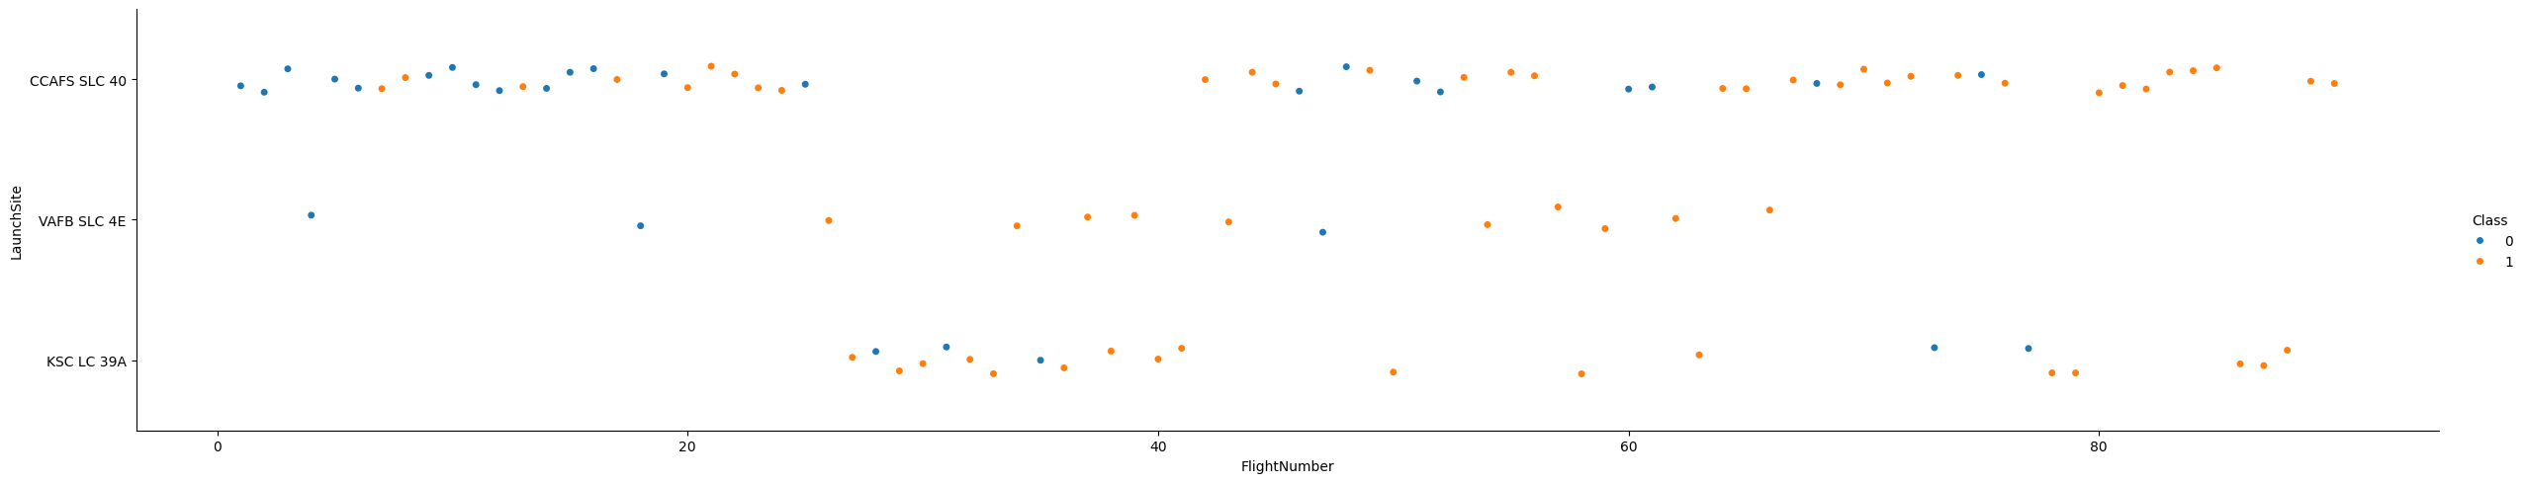
Flight Number vs. Launch Site

Slide 34
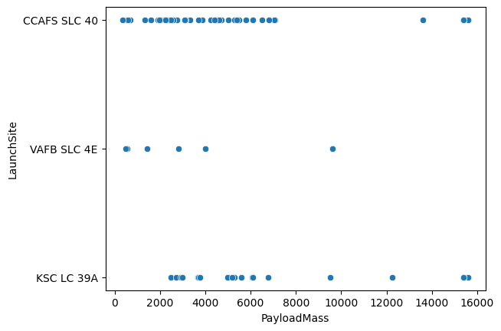
Payload vs. Launch Site

Slide 35
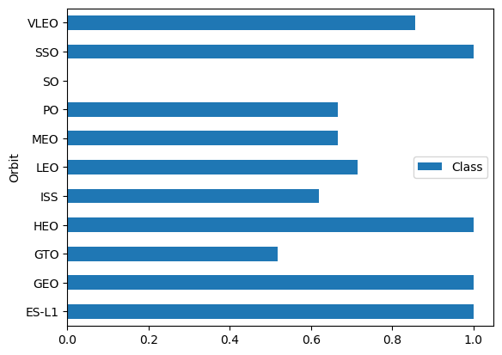
Success Rate vs. Orbit Type

Slide 36
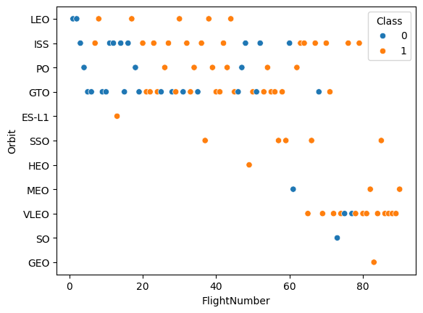
Flight Number vs. Orbit Type

Slide 37
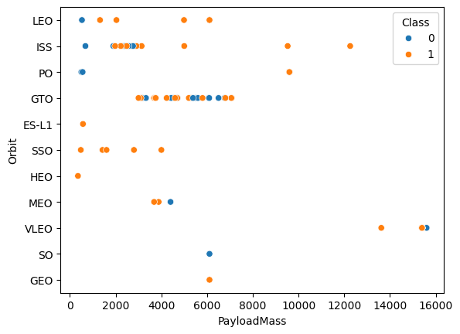
Payload vs. Orbit Type

Slide 38
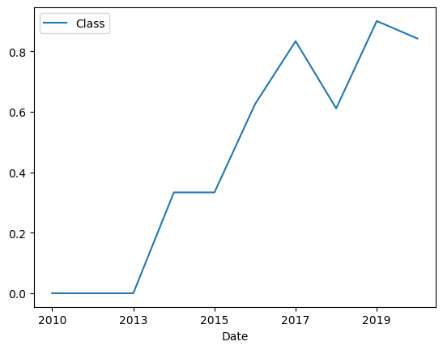
Launch Success Yearly Trend

Slide 39
All Launch Site Names
CCAFS LC-40
VAFB SLC-4E
KSC LC-39A
CCAFS SLC-40

Slide 40
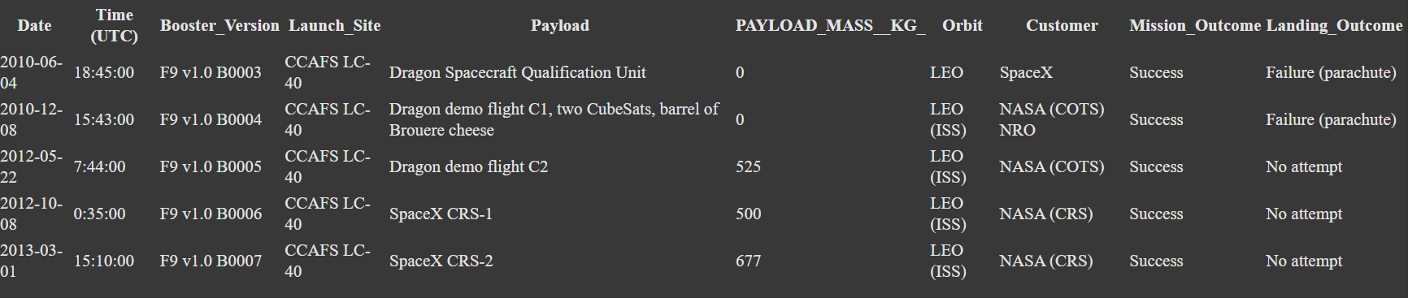
Launch Site Names Begin with 'CCA'

Slide 41
Average Payload Mass by F9 v1.1
2534.6666666666665

Slide 42
First Successful Ground Landing Date
2015-12-22

Slide 43
Successful Drone Ship Landing with Payload between 4000 and 6000
F9 FT B1022
F9 FT B1026
F9 FT B1021.2
F9 FT B1031.2

Slide 44
Total Number of Successful and Failure Mission Outcomes
Failure (in flight): 1
Success: 98
Success: 1
Success (payload status unclear): 1

Slide 45
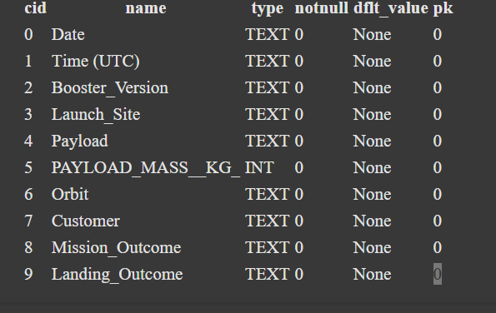
Boosters Carried Maximum Payload

Slide 46
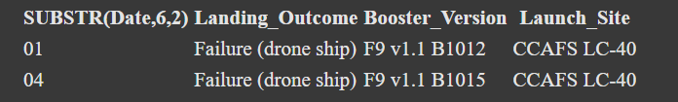
2015 Launch Records

Slide 47
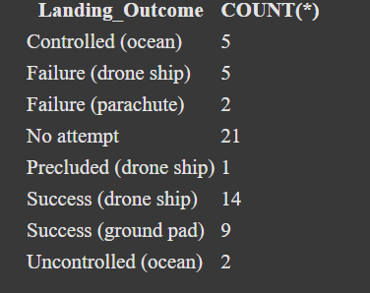
Rank Landing Outcomes Between 2010-06-04 and 2017-03-20

Slide 48

Section 3

Slide 49
Classification Accuracy
Logistic Regression : 0.83
SVM: 0.83
Decision Tree: 0.83
kNN: 0.83

Slide 50

Confusion Matrix
Logistic Regression
SVM

Slide 51
Confusion Matrix
Decision Tree
kNN

Slide 52
Conclusions
Key Drivers Identified: Landing success is most influenced by payload mass, orbit type, launch site, and booster version; later flights show experience effects.
Operational Trend: Year-over-year success rates improved steadily, reflecting process and hardware maturation.
Predictive Capability: The best-performing classification model (after tuning) achieves strong accuracy with balanced errors, enabling pre-launch risk estimation.
Actionable Insight: Operating within specific payload bands and orbit profiles can increase success likelihood; site-level practices can be benchmarked from the top-performing site(s).
Data Quality & Reproducibility: Combining API and curated web tables, with rigorous wrangling, produced a clean, auditable analytics dataset.
Limitations & Next Steps: Address residual class imbalance, enrich with weather/trajectory features, and deploy a calibrated probability model for decision thresholds.

Slide 53
Appendix
Include any relevant assets like Python code snippets, SQL queries, charts, Notebook outputs, or data sets that you may have created during this project

Slide 54


